Slide 1
Understanding Behavior
Why this matters for business success

Slide 2
Serious
Data-driven
Cautious
Empathetic
Fast-paced
Direct
Orderly
Formal
Reserved
Informal
Assertive
Driven
Energetic
Intense
Informal
Social
Independent
Task-focused

Slide 4
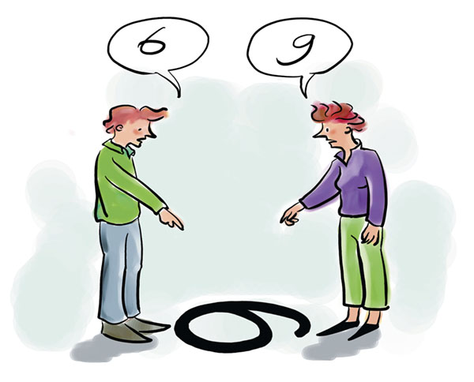
Why understand behavior?

Slide 5
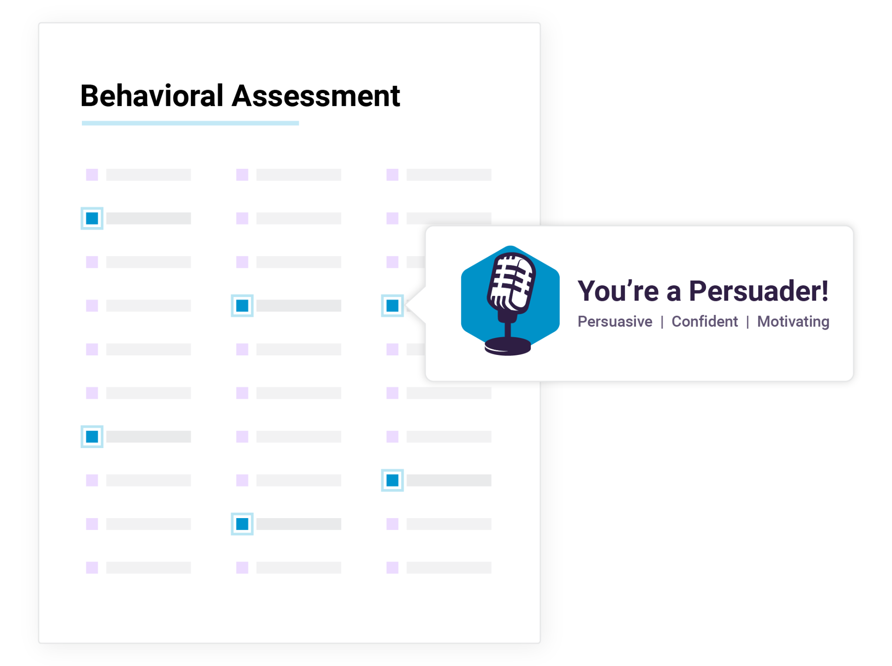
6 minutes to complete
No right or wrong answers
Open choice
Scientifically validated
68 languages
2 questions

Slide 7
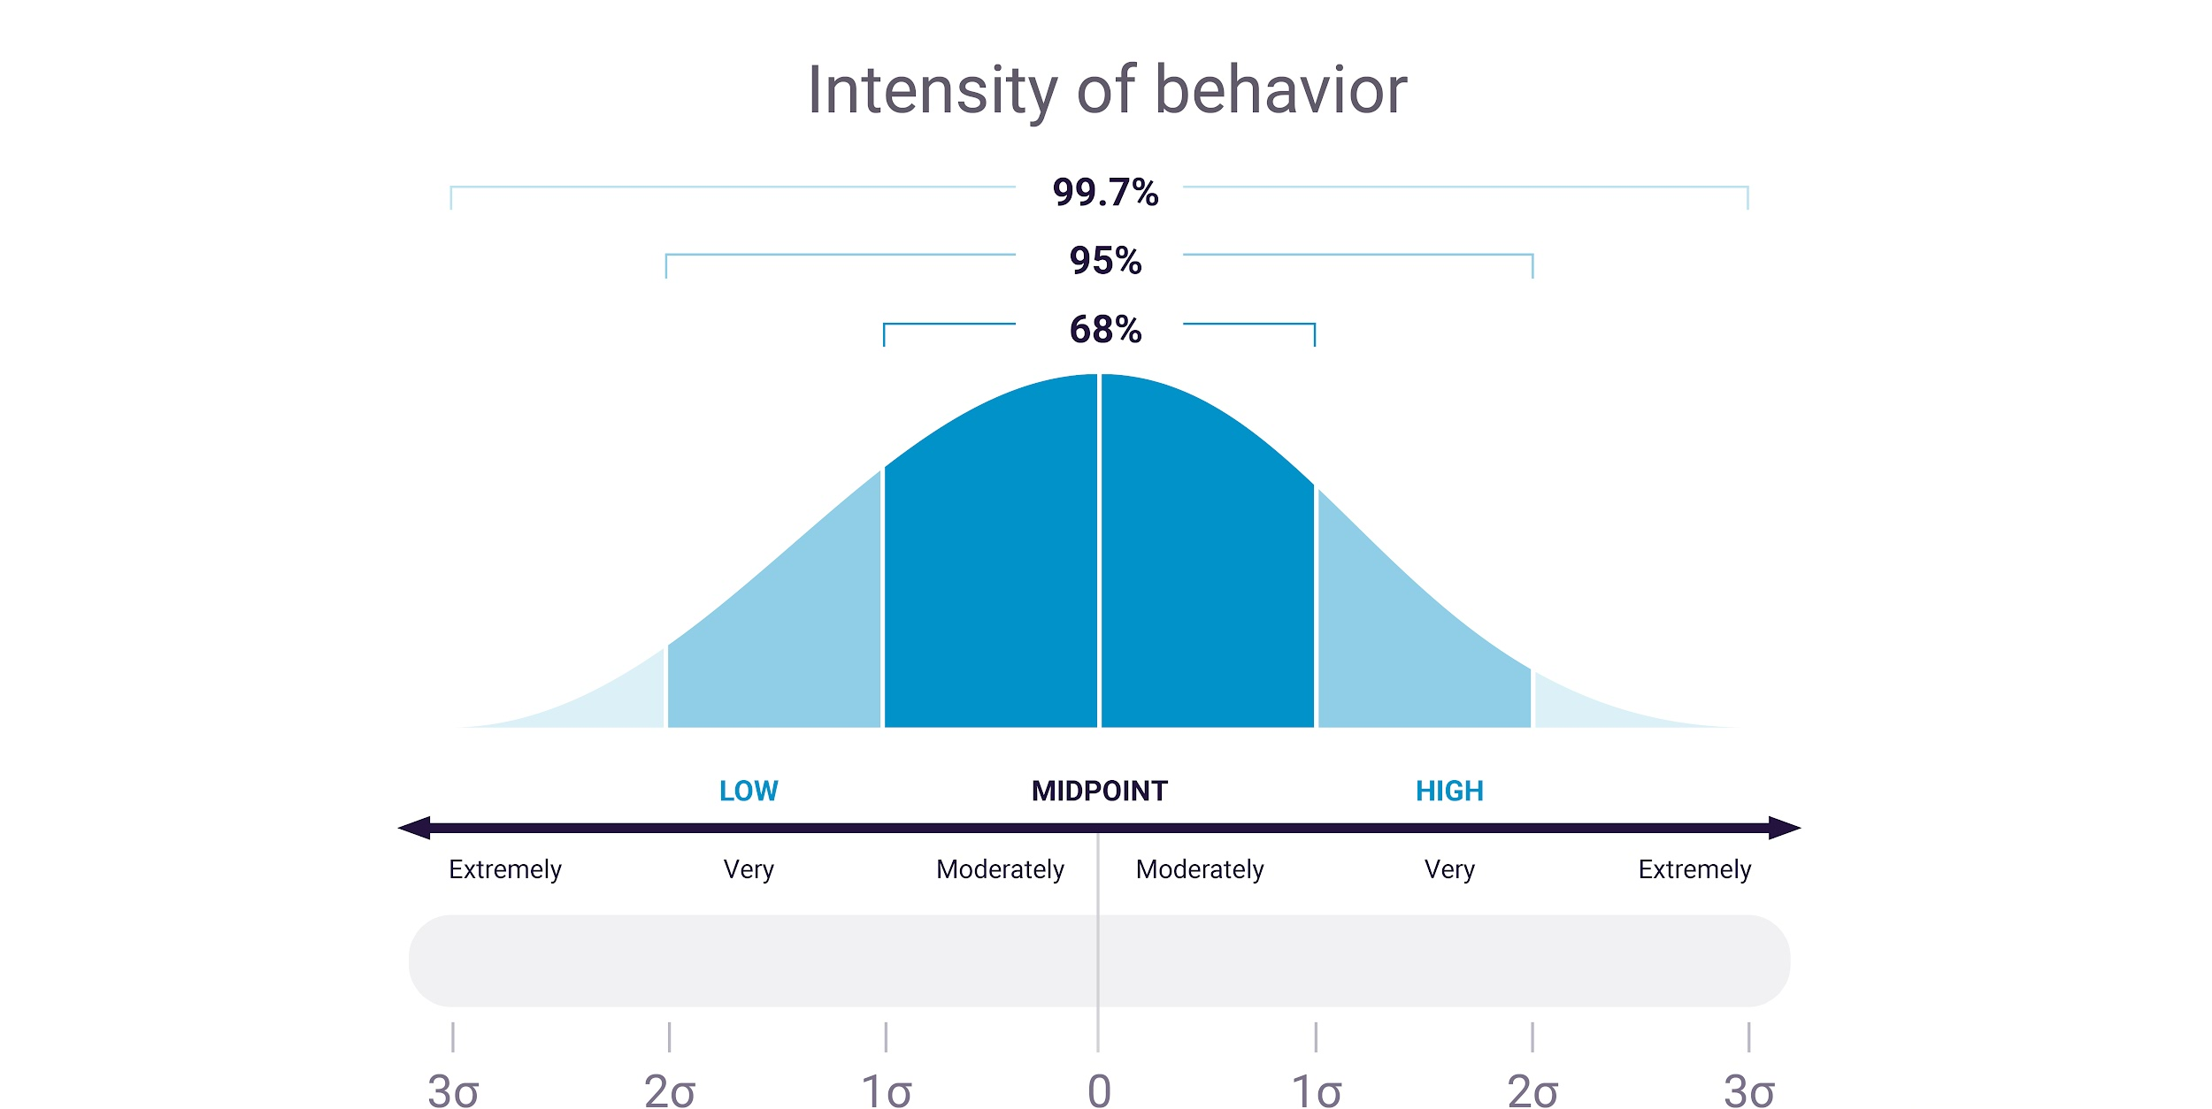

Slide 8
PI’s 17 Reference Profiles
Social
Analytical
Stabilizing
Persistent

Slide 9
Right person, wrong role
Candidate/Employee
Person
Role
Behavioral Job Target: Salesperson
Fit Rating:

Slide 10
?
Notes:
Head - Heart - Briefcase: What we typically see when it comes to people is a…
Focus on the briefcase - they’re past experience, or their performance in their current role, (and this certainly can provide some information). We can gather some information from resumes.
The heart - especially when hiring, promoting, succession planning (are they the right culture fit…etc). We can gather some information from interviews.
But - nobody really knows what's driving an individual (this is the question mark in the head)
And this is the gap, that if filled, makes things better for everybody

Slide 11
Right person, right role.
Candidate/Employee
Person
Role
Behavioral Job Target: Salesperson
Fit Rating:

Slide 12
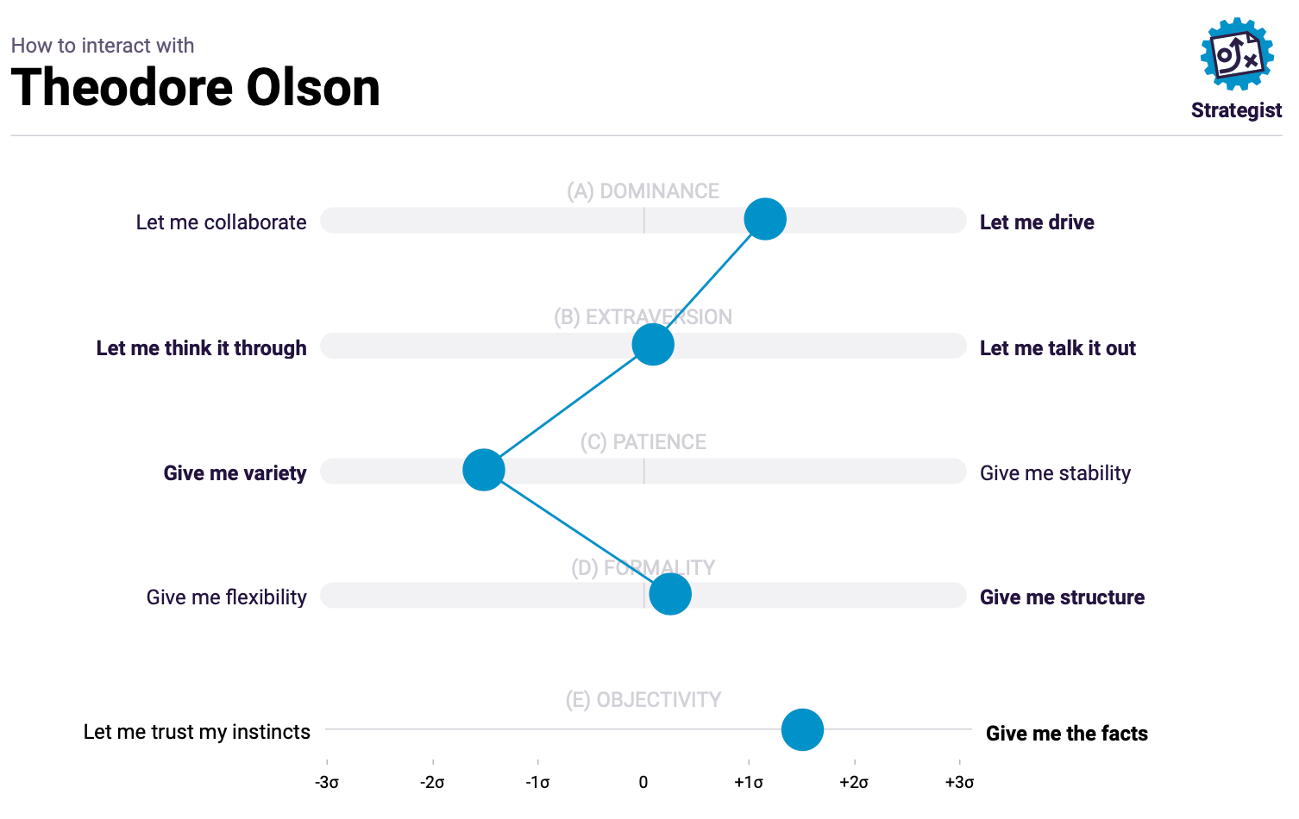
My Behavioral Pattern

Slide 13
Does my co-worker “get me?”
Relationship Guide
Customer Support
Sales Rep
Guardian
Persuader
Patient
Reserved
Risk-mitigator
Driving
Outgoing
Risk-taker
= Customer Support
= Sales Rep

Slide 14
Does my manager “get me?”
Direct Report
Manager
Reserved Likes to think things through
Risk-mitigator Uncomfortable with ambiguity
Stable Calm, enjoys consistent work
Social Likes to talk everything out
Risk-taker Comfortable with ambiguity
Driving Fast-moving, sense of urgency

Slide 15
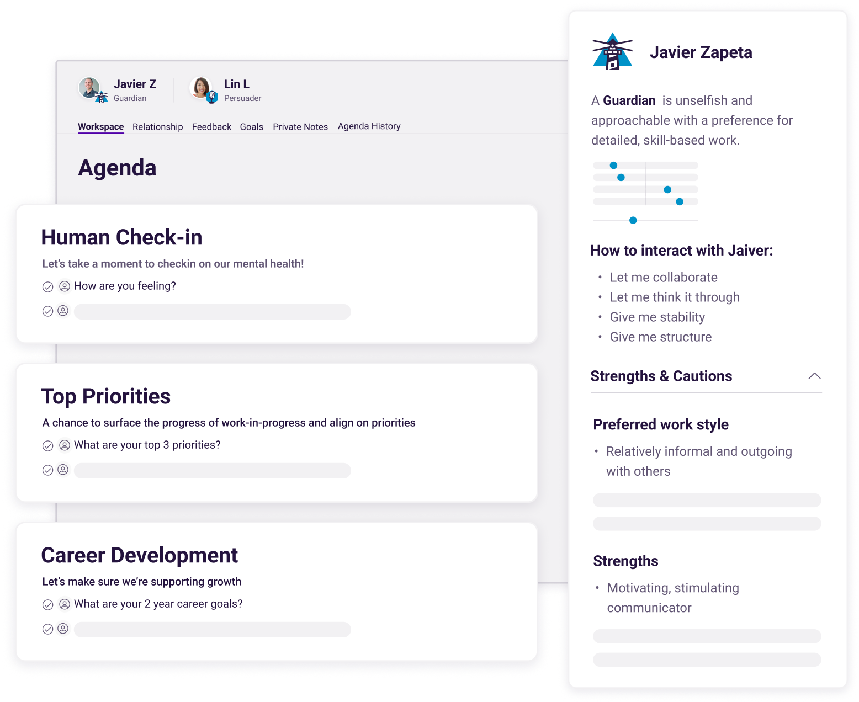
Behavioral Data in Action

Slide 16
Next Steps
Take the PI Behavioral Assessment
[Partner choice - see notes]
Apply to urgent goal/need

Slide 17
ACTIVITY
OPTIONAL

Slide 18
5-minute getting to know you exercise
What you need:
Activity:
Grab your BA
Find a partner
Take turns sharing 2 examples of yourself at work (a positive & caution)
Objective:
Build self-awareness
Build other-awareness
Build understanding, trust

Slide 19
APPENDIX

Slide 20
Aligning teams
Teamwork
Innovation
Team members
Leader
Work
Process
Results

Slide 21
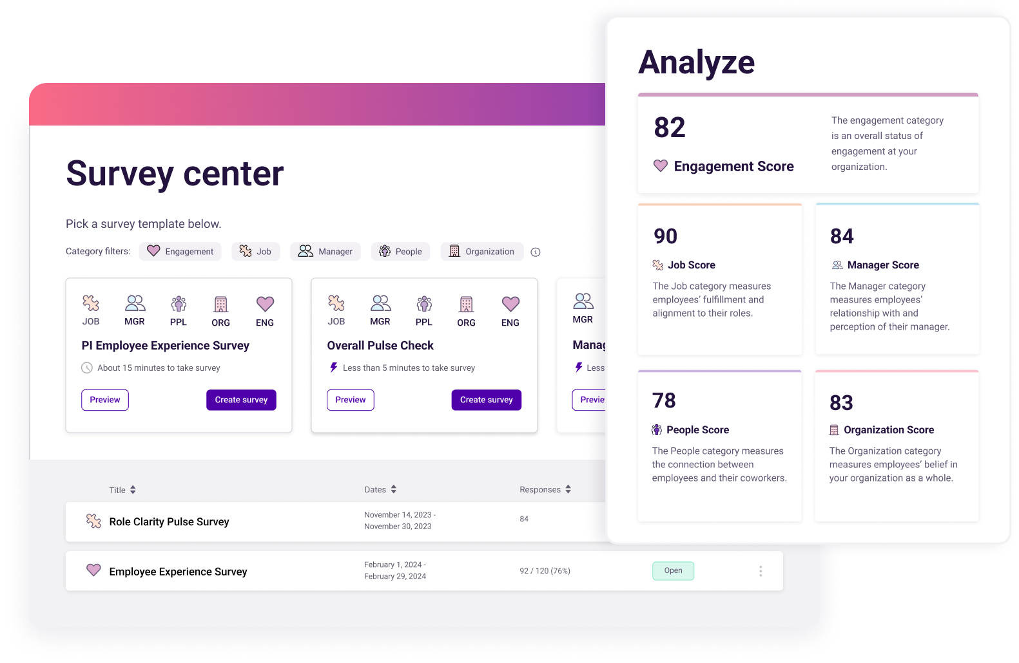
Diagnosing Engagement

Slide 22
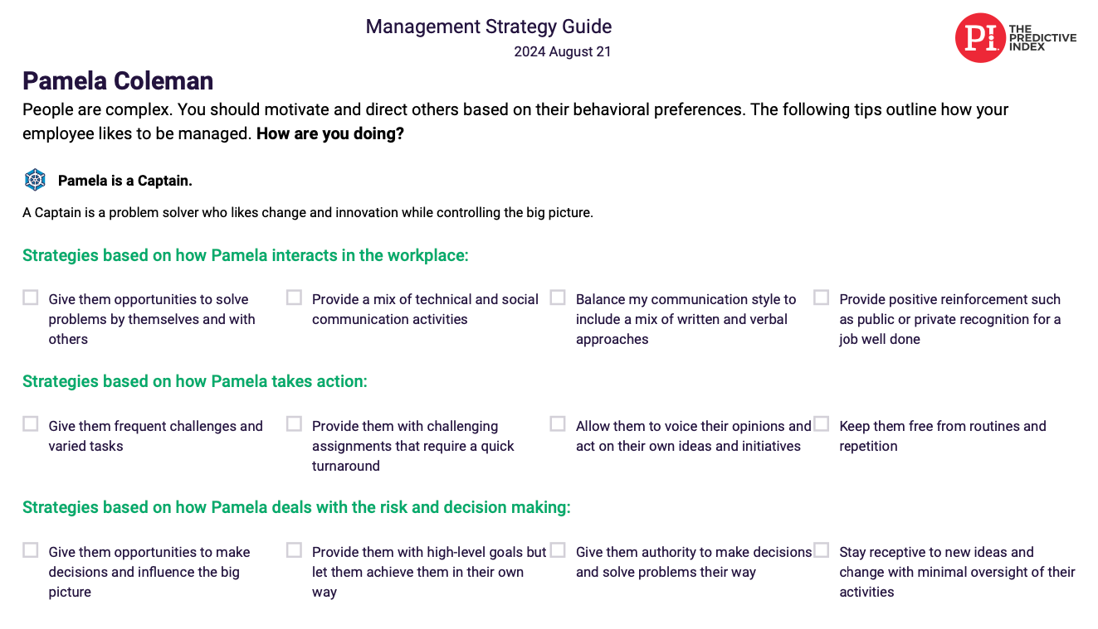
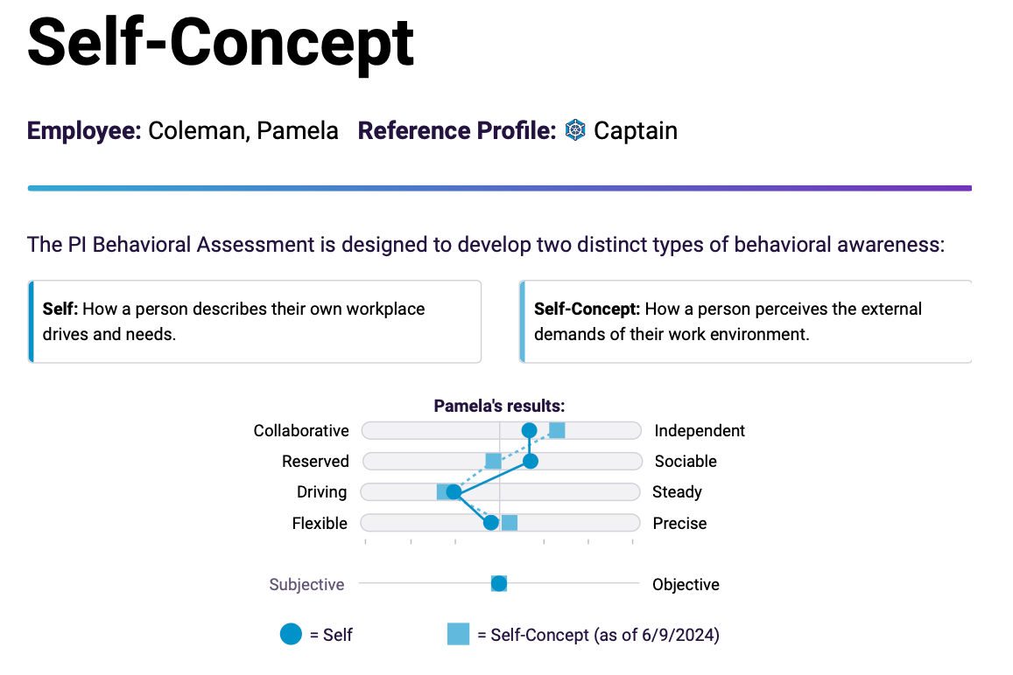
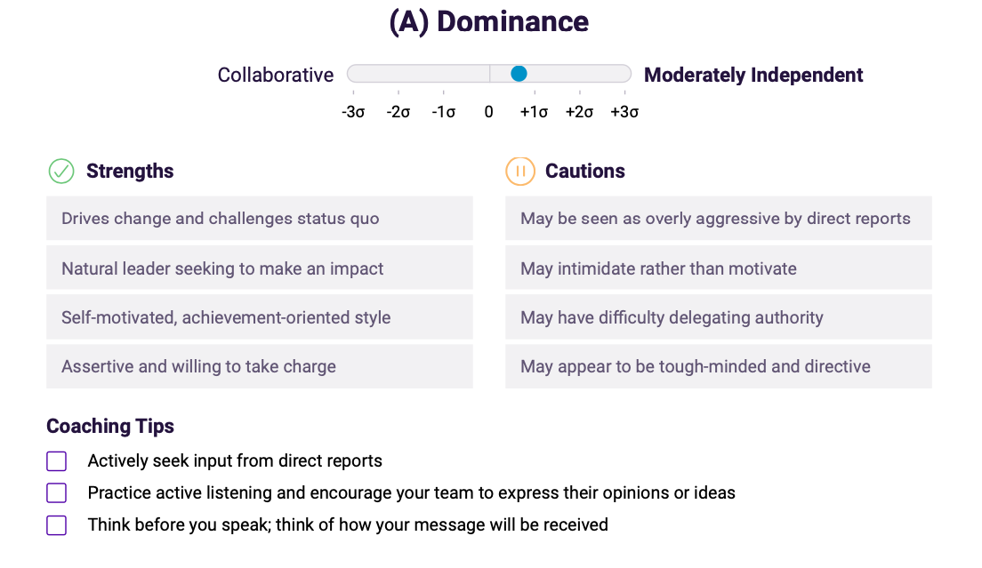
Professional Development Tools

